Slide 1
Bureau of Meteorology Update
GODEX-NWP, New Delhi, 2018
Agnes Lane
Observing Strategy Team leader
Data Requirements and Quality section
Data Program
Australian Bureau of Meteorology

Slide 2
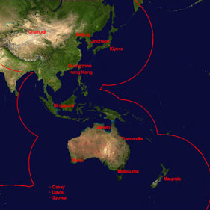
Satellite Activities
New
COSMIC-2 antenna ready for operation
Planned/underway:
Polar-tracking antenna in Western Australia
Reception of GK-2A and FY-4
Satellite products
SSTs
Himawari AMVs
DBNet
JPSS/Metop data still not available (sorry!)

Slide 3
Non-satellite Observations
Upper air
All 41 balloon sites have migrated to high res BUFR
Converting to RS41 sondes (32 have transitioned)
GB-GNSS
Data from Australian network expected to be available on GTS in 2019

Slide 4
NWP Update
Version APS-2 of the Bureau of Meteorology’s global (deterministic) ACCESS-G ("G2") numerical weather prediction system was operationally commissioned on Wednesday 16 March 2016.
Version APS-3 will be operational in March 2019
G2 (2016)
25 km spatial
70 vertical levels
4dVAR data assimilation
G3 (2019)
12 km spatial
85 vertical levels
4dVAR data Hybrid

Slide 5
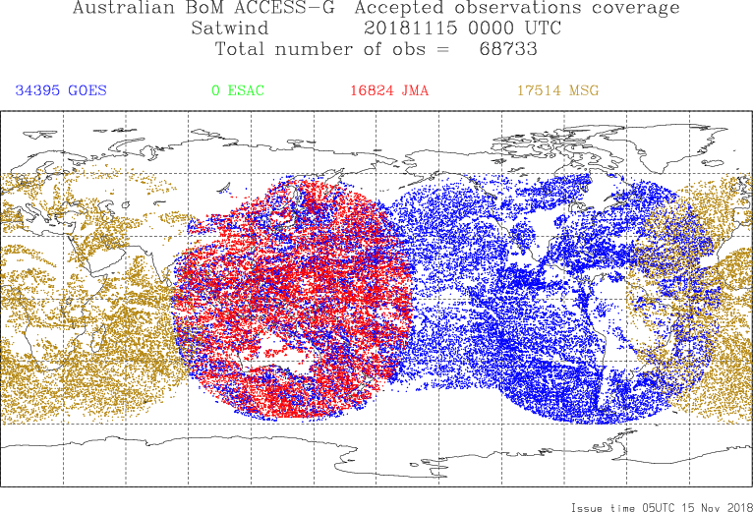
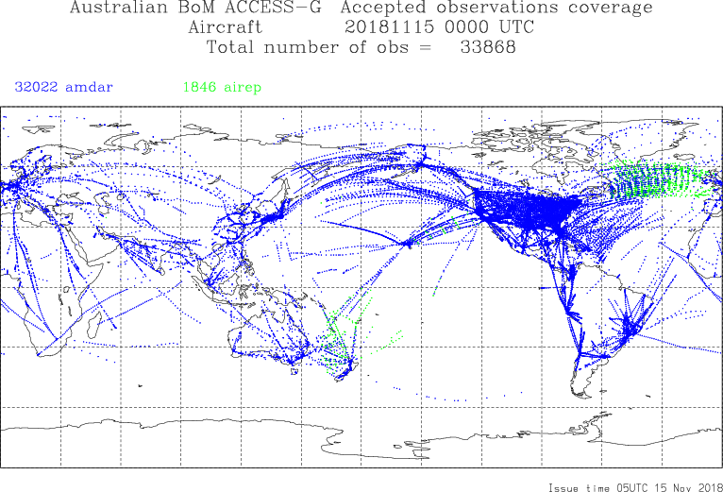
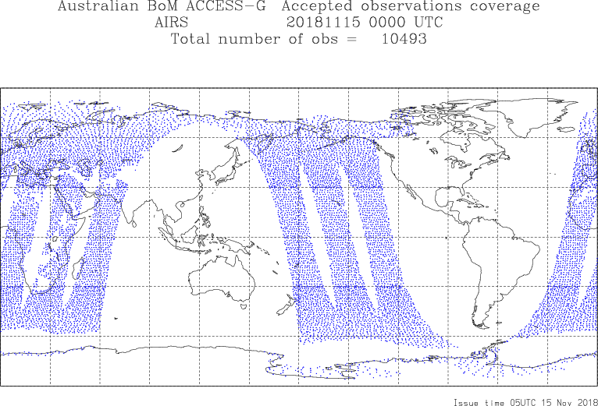
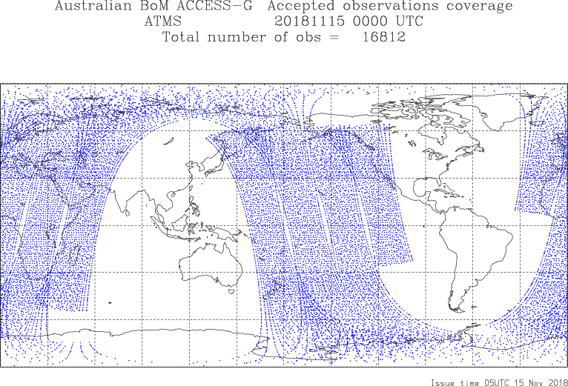
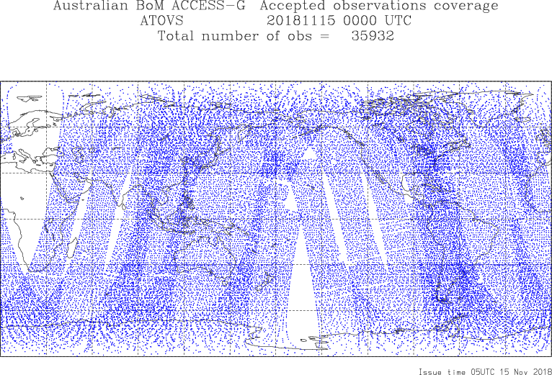
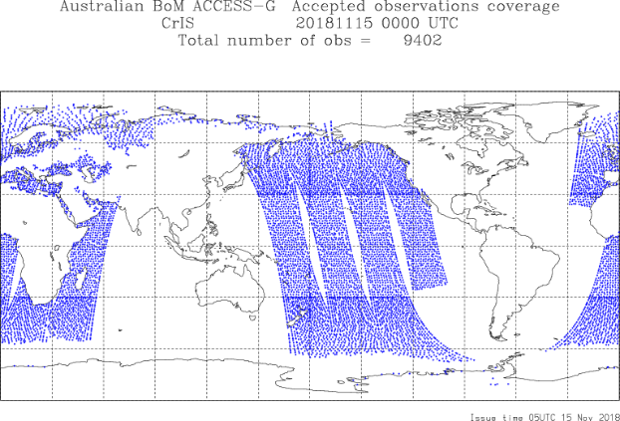
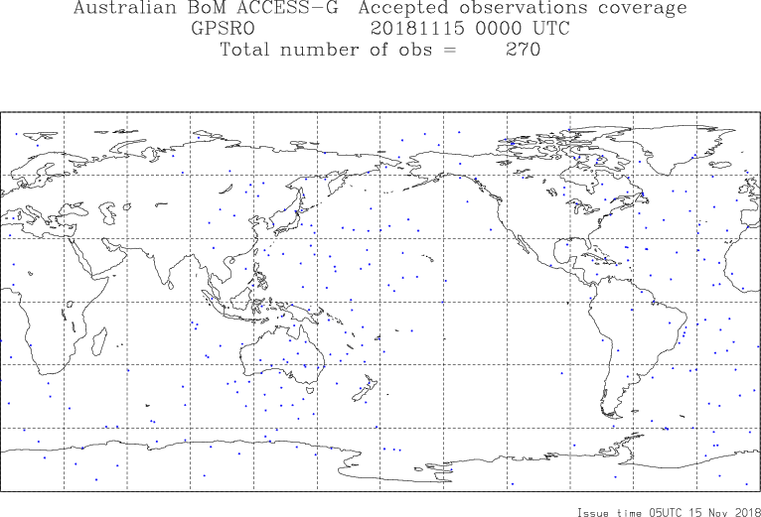
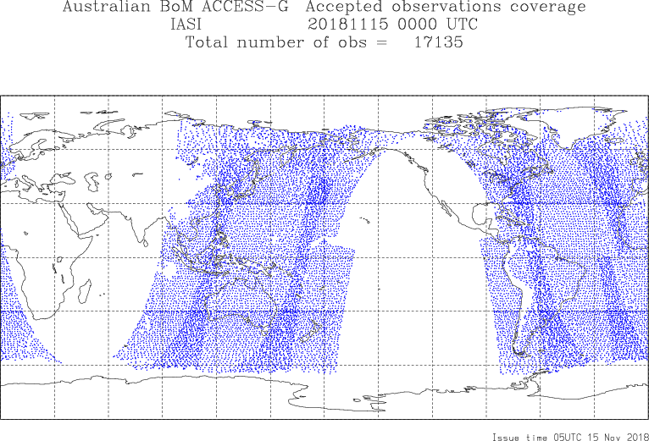
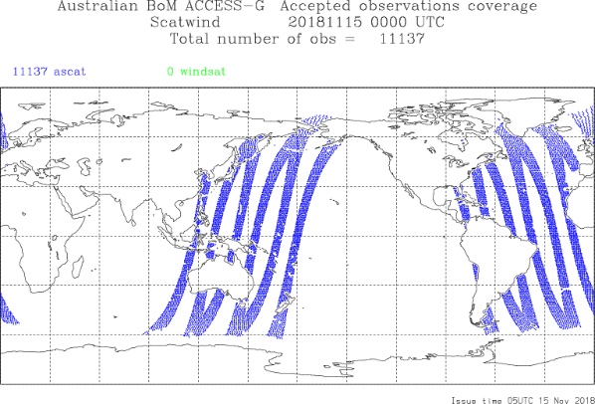
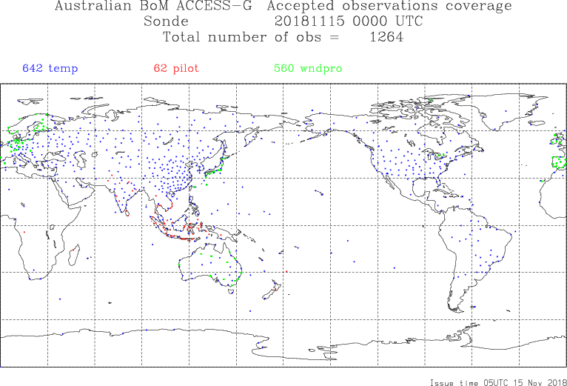
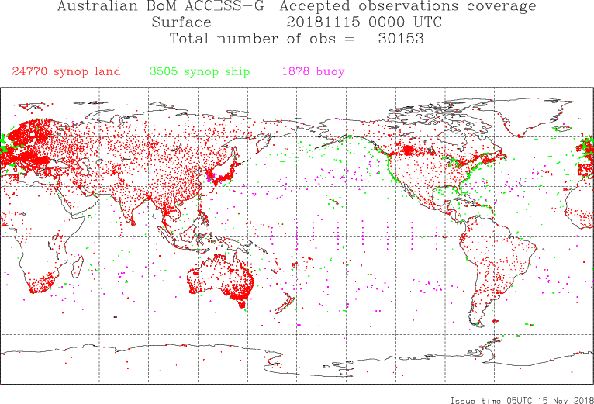
GEO AMVs
AMDAR
AIRS
ATMS
ATOVS
CrIS
GPSRO
IASI
ASCAT
Sondes
SYNOP + BUOY

Slide 6
Data assimilation priorities next 12 months
Next model update
SSMIS
NOAA-20 ATMS/CrIS radiances
GCOM-W1 AMSR-2 radiances
GOES CSR
Himawari-8/9 CSR and ASR
ScatSat-1 OSCAT
TerraSAR-X bending angle and refractivity
Also a priority
LEO/GEO winds
Backup altimeter data stream
Sea-ice distribution and ice-edge for global sea-ice model (2019/20)

Slide 7
Adjoint-based Forecast Sensitivity to Observations (FSO)
The Met Office version of the FSO technique has been implemented in conjunction with the operational ACCESS global NWP (ACCESS-G)
FSO has been running for 3 years, and we have completed several assessments of the forecast sensitivity of ACCESS-G to the various components of the Global Observing System, and to particular components of the Australian observing network:
ATOVS ground stations review
PNG work (quantifying the value of PNG upper air obs)
Wind profiler assessment
Remote stations
Notes:
In collaboration with the UK Met Office
Aggregates forecast error reduction due to each individual observation
Allows for assessment of the impact of observation types, particular instruments, networks and sub-networks, groups of stations etc.
Only assesses impact of an observation in the presence of all other observations; doesn't tell you directly the effect of removing an observation, or group of observations, or an observing system

Slide 8
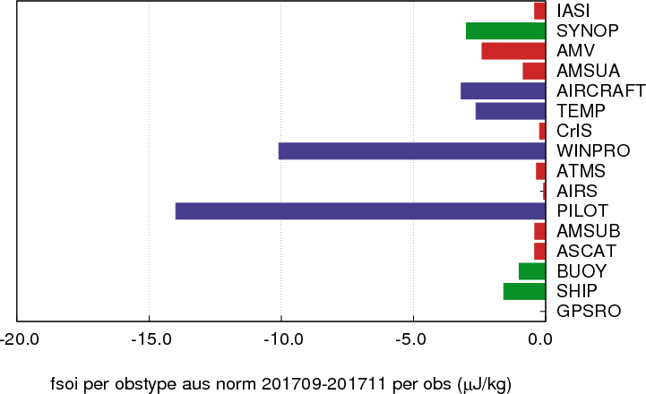
FSO Observing System Impacts
Australian Region forecast error norm
Total impacts per observing system per day
Impact per observation

Slide 9
MAP: Synop FSOI from Australian and Australian/Antarctic stations (global error norm)
Grey: neutral impact; Blue: detrimental; Yellow-Red: beneficial (red most beneficial)

Slide 10
FSOI of radiosonde observations north of Australia in ACCESS-G
Motivation: establish impact of radiosonde observations north of Aus, W. Pacific, with a view to support re-establishment of PNG RAOB program
Maps show total impacts (J/kg) on the 24h forecast error in operational ACCESS-G for the period shown: error measure is the global moist energy norm. Negative impacts represent a reduction in forecast error.

Slide 11
GISC Melbourne Portal (update from TT-GISC2018, September 2018, Geneva)
Monitoring Activity & volume
Conducted GISC Watch from 1st to 15th June 2018
Cache volume: ~1.8G/day (GTS input)
Data dissemination: ~ 6G/day
Uptime: 99.99%
Active user registration: 30 (WIS system only, excluding MSS, FTP users)
Outlook (planned changes/improvements)
Scheduled maintenance only.
Link to Fiji changed from Frame Relay to the internet.
Link to Manila via internet in progress.
Contact: Weiqing QU

Slide 12
Thank you
agnes.lane@bom.gov.au

